Slide 1
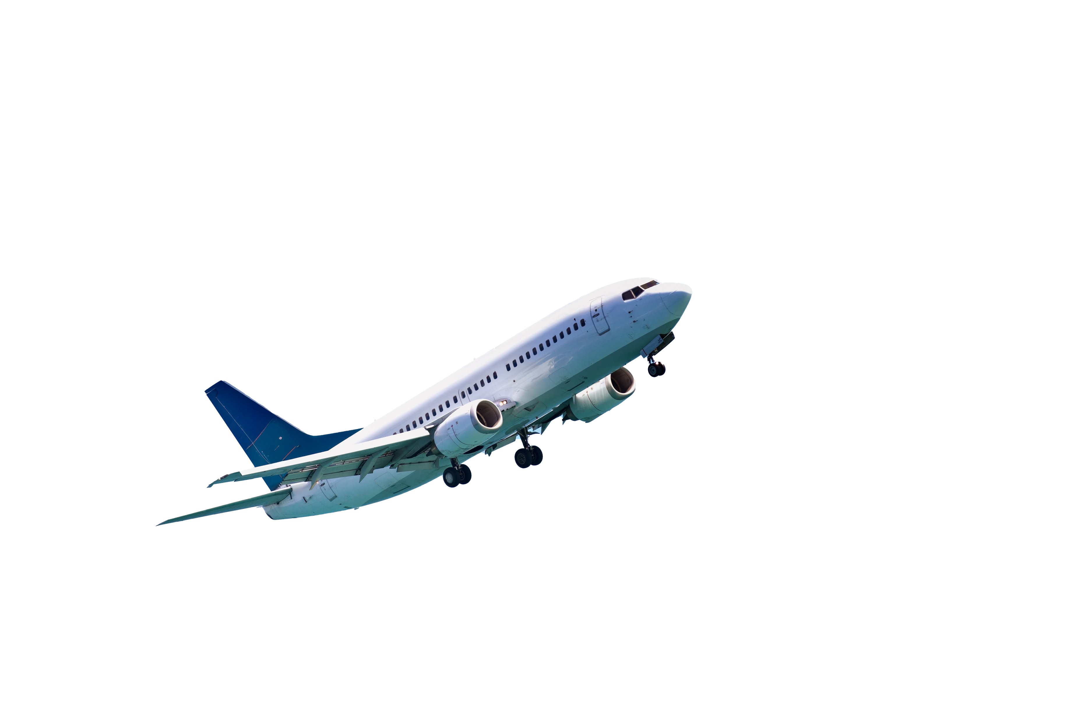


Manston Airport Airspace Consultation – Stage 3
Consultation Overview

Slide 2
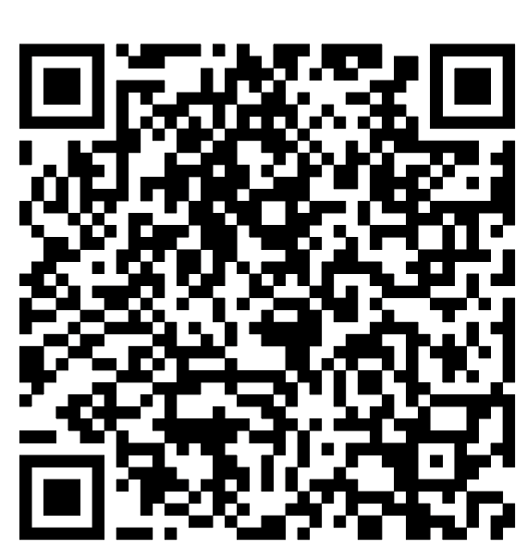
Background
RiverOak Strategic Partners (RSP) proceeding with the reopening Manston Airport.
Development Consent Order (DCO) application was approved in August 2022,
but project progress has been delayed due to legal challenges.
This consultation focuses solely on the proposed design of the airspace and procedures
above Manston and is not about re-opening the airport or ground infrastructure.
A submitted and approved Airspace Change proposal is required for the airport
to reopen and the airspace to be activated.
We are currently at Stage 3 of the airspace change process, which is where
we consult with our stakeholders on our proposals for how the flight paths
at the airport will be routed and managed.
All relevant airspace change materials will be available on the Civil Aviation Authority (CAA) portal.

Slide 3
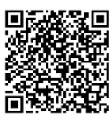
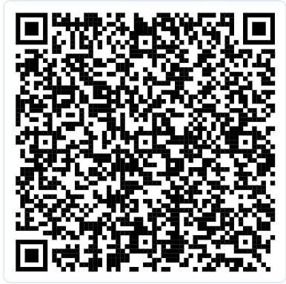
The consultation
This consultation relates only to the CAA CAP1616 process and the proposal to introduce the airspace and Instrument Flight Procedures (IFPs) required to enable safe and efficient operations to and from Manston Airport.
Our proposals
Full details of our proposals can be found here, or by scanning the QR code.
How to respond to the consultation
You can respond to the consultation by completing an online form or by scanning the QR code.
Alternatively, you can submit a written response to our Freepost address: FREEPOST 1616
The consultation commenced on 16 March and runs until 22 June 2026.

Slide 4

Our proposals
Individual procedures

Slide 5
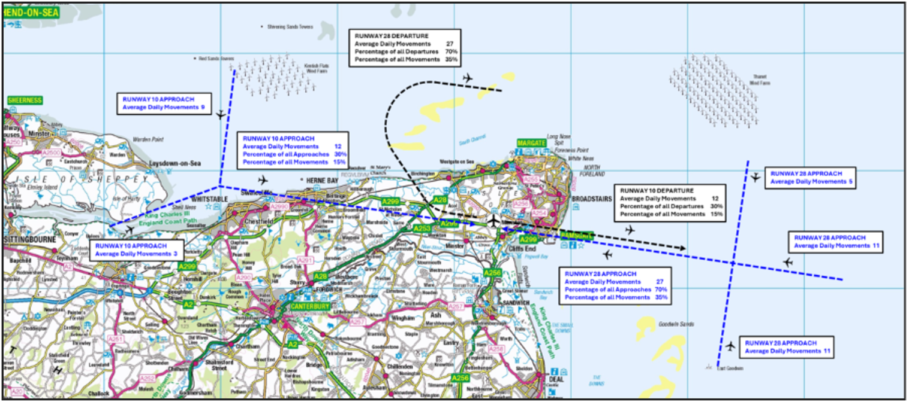
Operational Picture at Manston
The operational picture at Manston shows the expected average number of daily movements utilising each departure and approach procedure for Year 10 (2038).
For further details see section 4 in the Consultation Document.

Slide 6
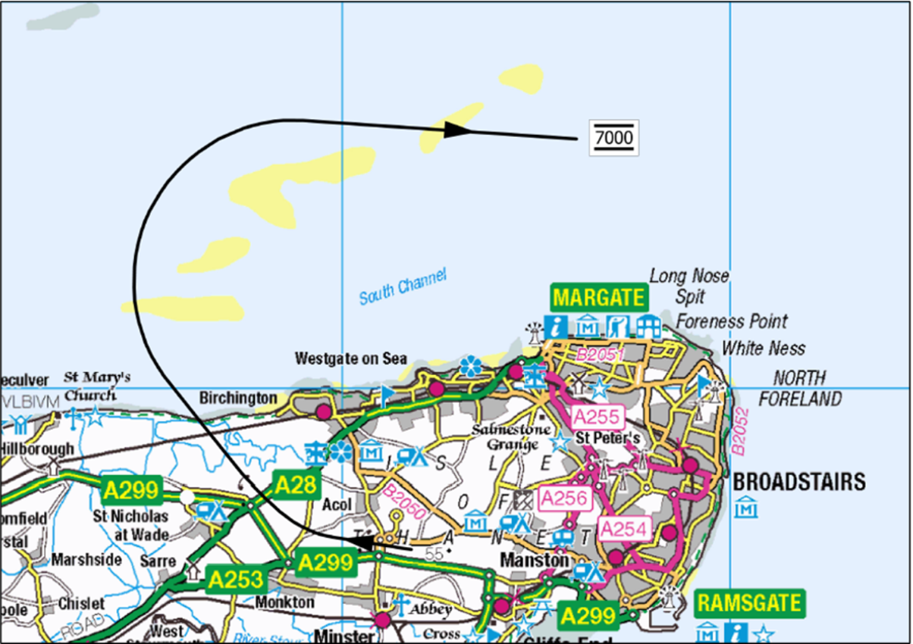
Map 1 - Runway 28 Departure
Map 1 shows the departure from runway 28 and expected routing
of aircraft until they reach 7,000 ft.
For further details see section 4.4.1 in the Consultation Document.

Slide 7
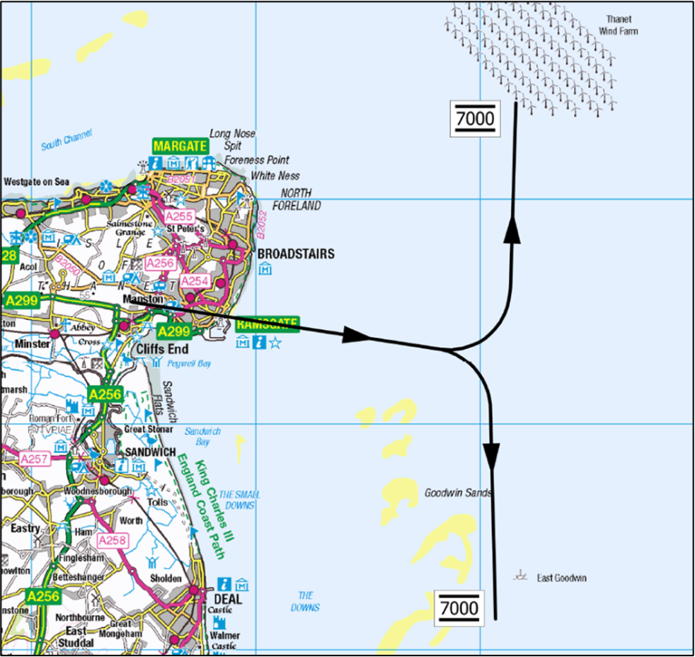
Map 2 - Runway 10 Departure
Map 2 shows the departure from runway 10 and the expected routing of aircraft until they reach 7,000 ft.
For further details see section 4.4.2 in Consultation Document.

Slide 8
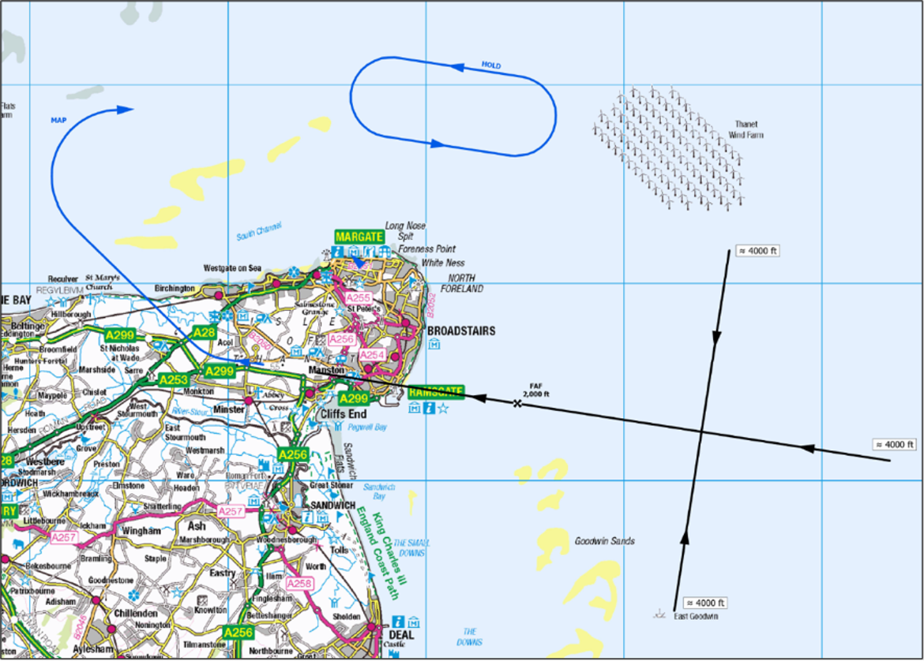
Map 3 - Runway 28 Approach
Map 3 shows the approach routings for runway 28.
If a landing can’t be completed safely, aircraft follow a planned route out over the sea (blue lines) before returning for another approach.
For further details see section 4.5.1 in the Consultation Document.

Slide 9
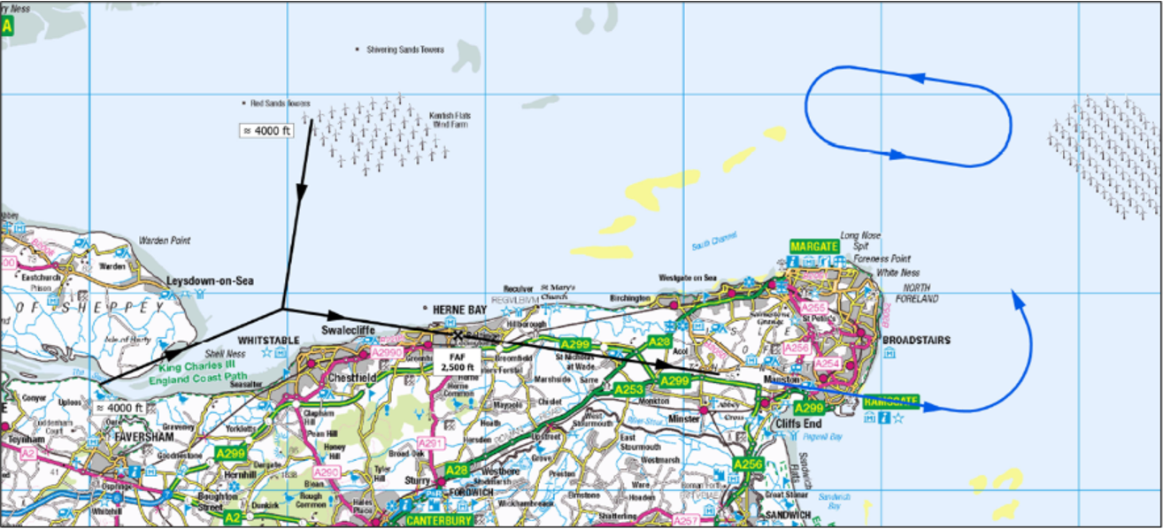
Map 4 – Runway 10 Approach at 2,500 ft
Map 4 shows the approach directions for runway 10 with the final descent commencing at 2,500 feet. If a landing can’t be completed safely, aircraft follow a planned route out over the sea (blue lines) before returning for another approach.
For further details see section 4.5.2 in the Consultation Document.

Slide 10
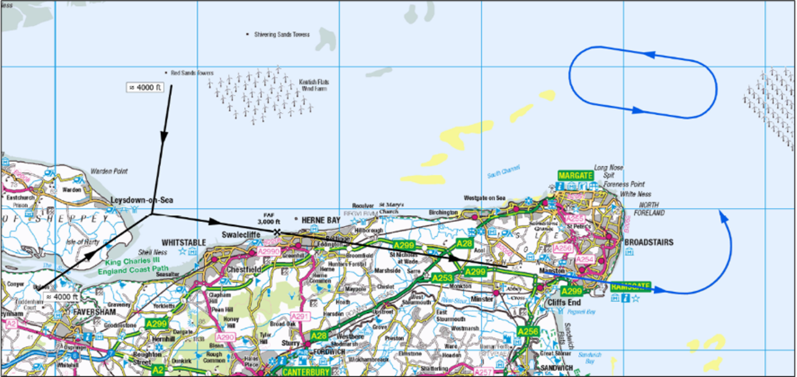
Map 5 – Runway 10 Approach at 3,000 ft
Map 5 shows approach routings for runway 10 with the final descent commencing at 3,000 feet. If a landing can’t be completed safely, aircraft follow a planned route out over the sea (blue lines) before returning for another approach.
For further details see section 4.5.3 in the Consultation Document.

Slide 11
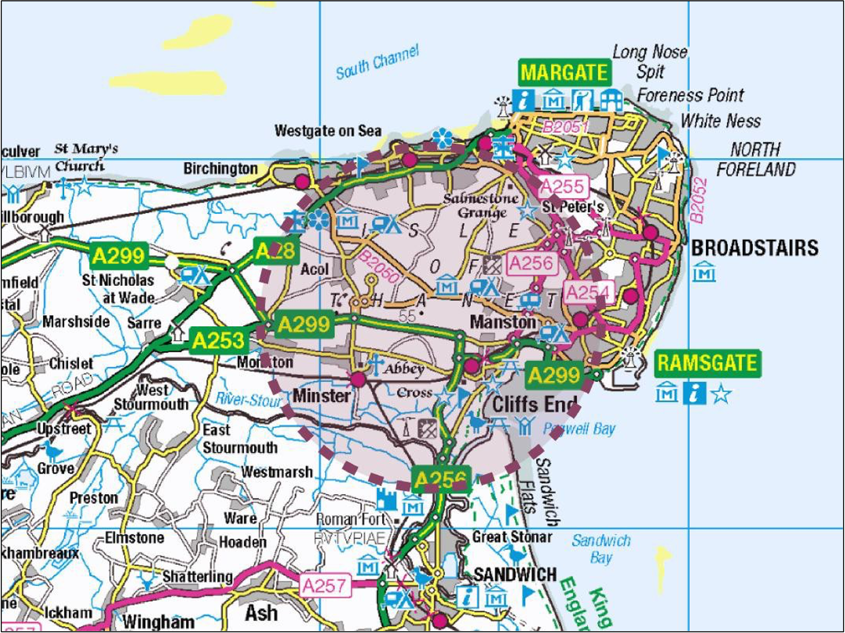
Aerodrome Traffic Zone
Aerodrome Traffic Zone (ATZ) – 2.5 nm radius, surface to 2,000 ft.
Class G Uncontrolled Airspace (no Controlled Airspace).
ATC permission required to fly in the ATZ.

Slide 12
Our proposals
Combination A

Slide 13
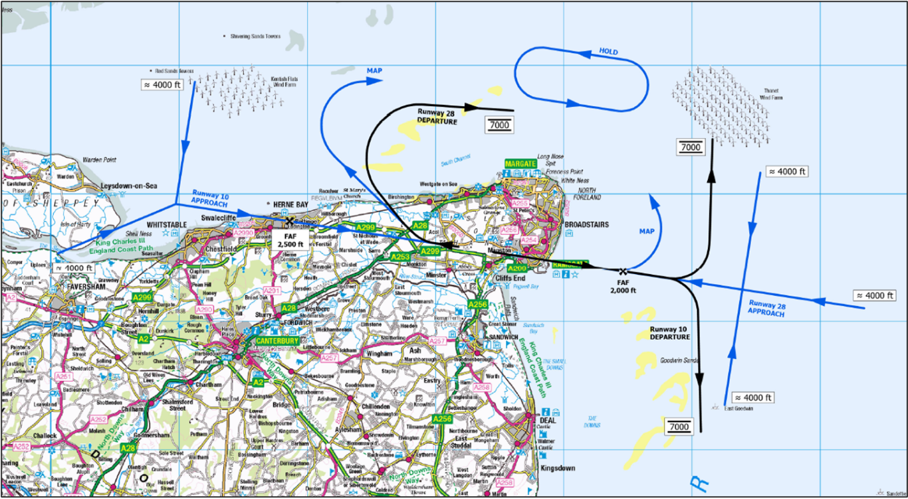
Map 6 - Design Combination A
Map 6 shows how the individual procedures have been combined to produce combination A.
For further details see section 5 in the Consultation Document.

Slide 14
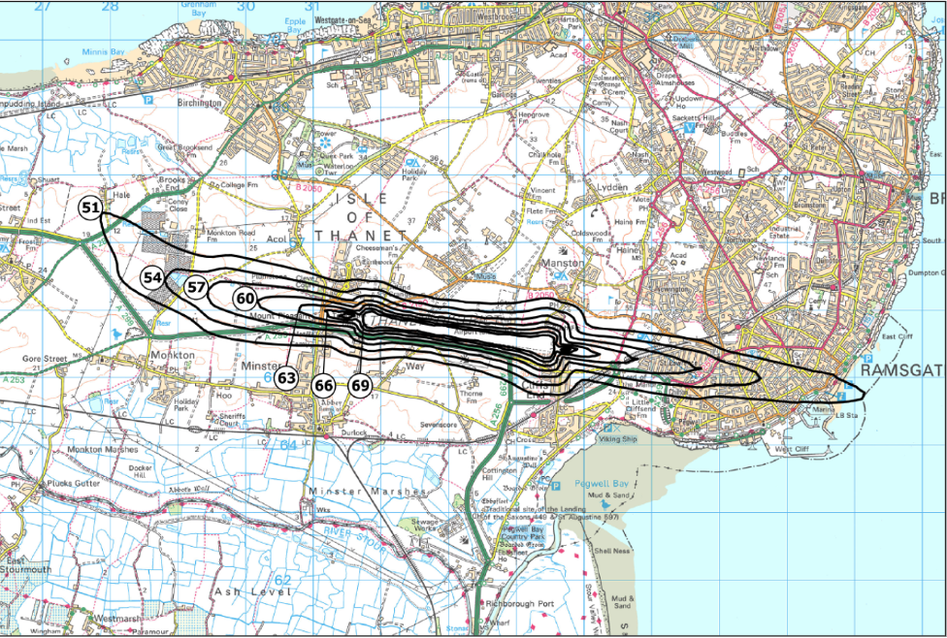
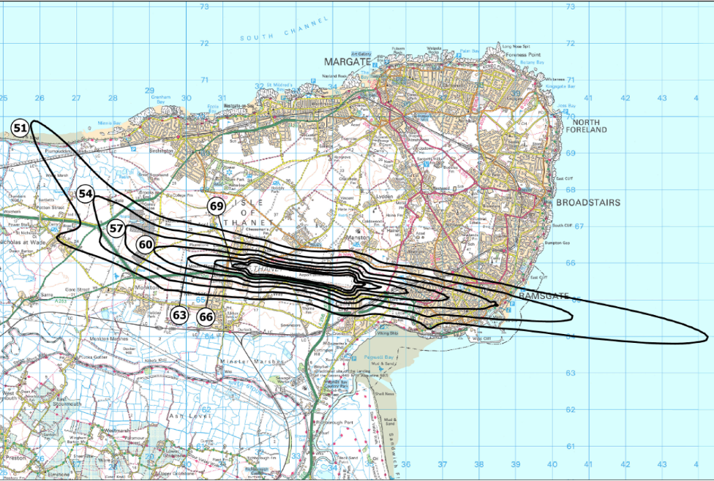
Combination A - Noise assessment
These maps show the calculated noise contour for the forecast Year 1 (2029) and Year 10 (2038) with average noise levels expected to exceed 51dBA Laeq 16hr; this represents the average noise levels for the 16-hour period between 0700 and 2300 hrs during the summer season.
For further details see section 5.3 in the Consultation Document.
Year 1
Year 10

Slide 15
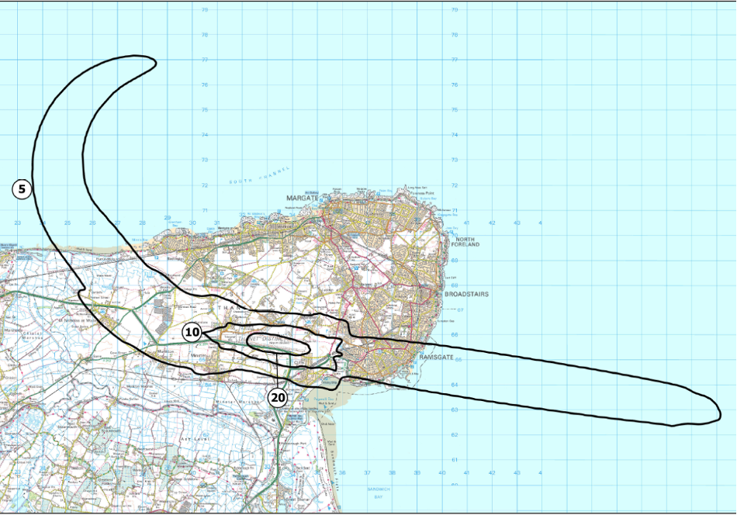
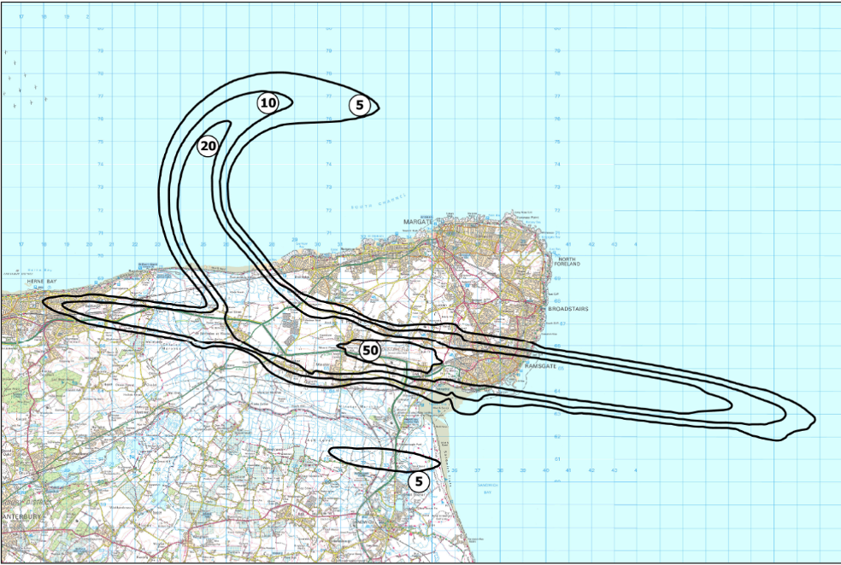
Combination A - Noise assessment
These maps show the N65 (day) noise assessments for the forecast Year 1 (2029) and Year 10 (2038). The contours show the number of events of noise exceeding 65dbA (N65) in the daytime, for an average 24 hours in the summer, that would be experienced by people living within the contour.
For further details see section 5.4 in the Consultation Document.
Night-Time Noise Assessment:
We have also assessed potential night-time noise (between 11pm and 7am).
In Year 1 (2029), there will be no scheduled night flights, so no night-time noise assessment is shown. For Year 10 (2038), our assessment found that no areas would experience five or more noise events above 60 decibels during the night, so no contours are displayed.
Year 1
Year 10

Slide 16
Our proposals
Combination B

Slide 17
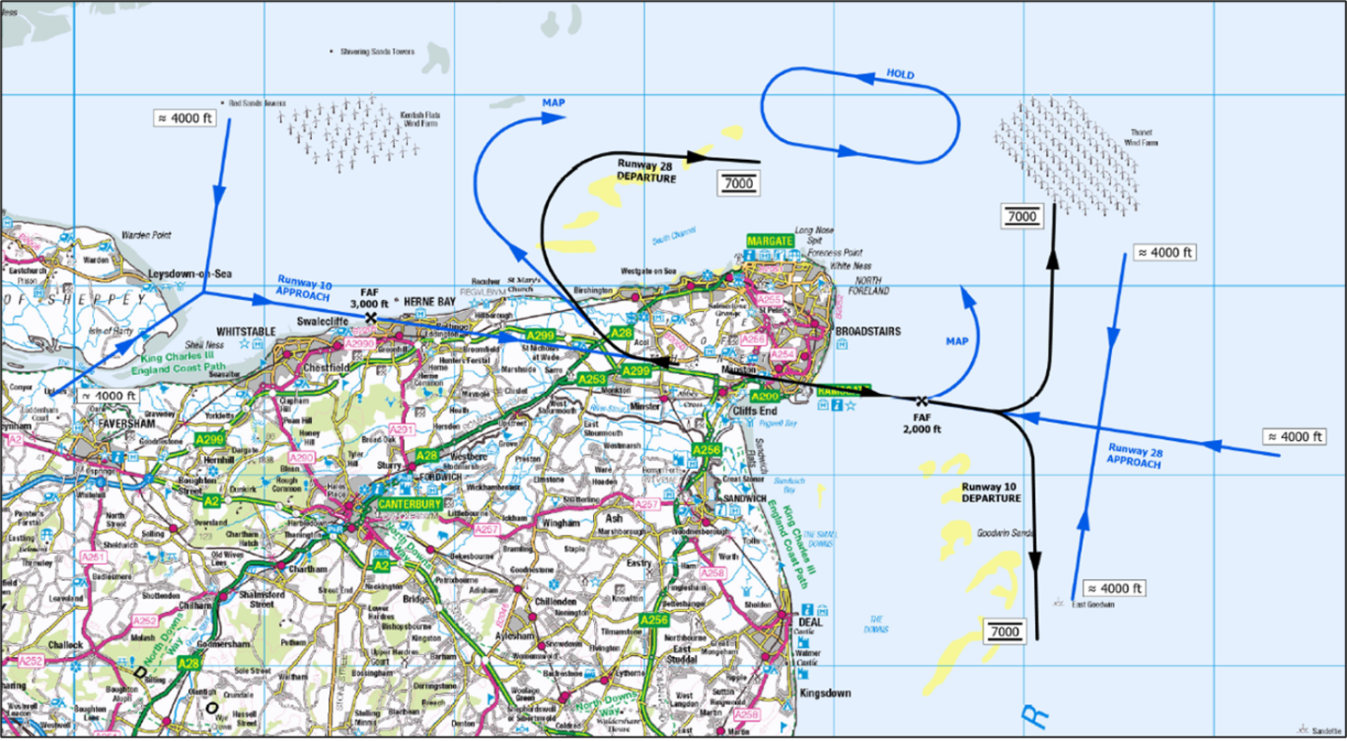
Map 7 - Design Combination B
Map 7 shows how the individual procedures have been combined to produce combination B.
For further details see section 6 in the Consultation Document.

Slide 18
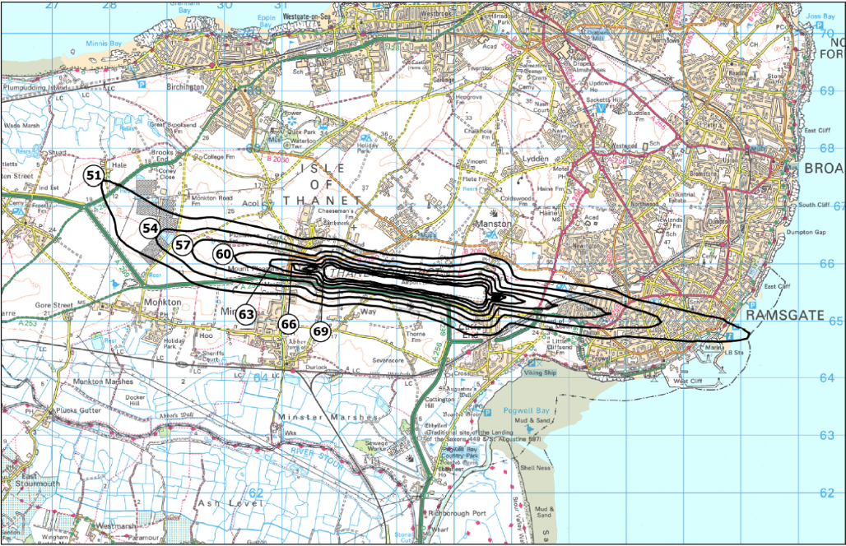
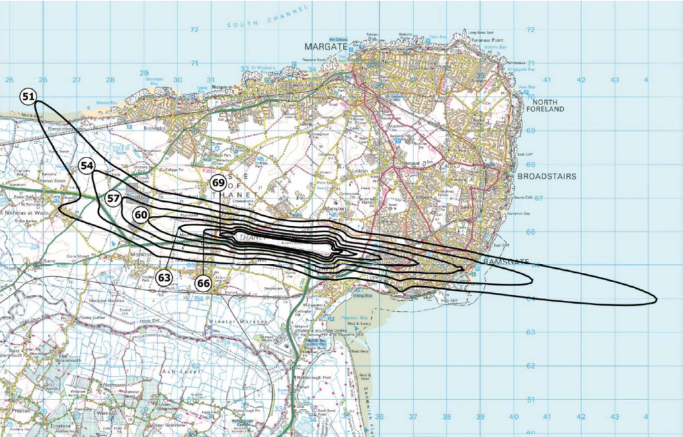
Combination B - Noise assessment
These maps show the calculated noise contour for the forecast Year 1 (2029) and Year 10 (2038) with average noise levels expected to exceed 51dBA exceed 51dBA Laeq; this represents the average noise levels for the
16-hour period between 0700
and 2300 hrs during the
summer season.
For further details see section 6.3 in the Consultation Document.
Year 1
Year 10

Slide 19
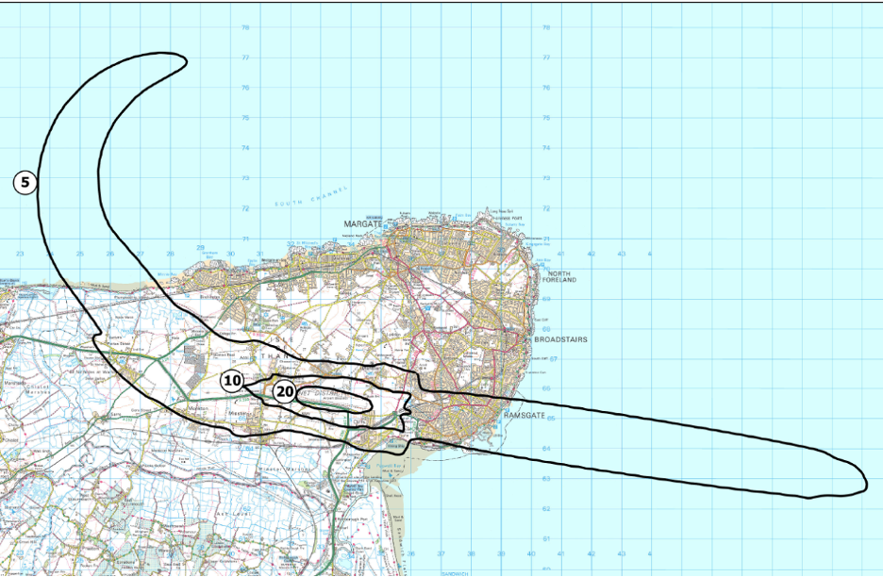
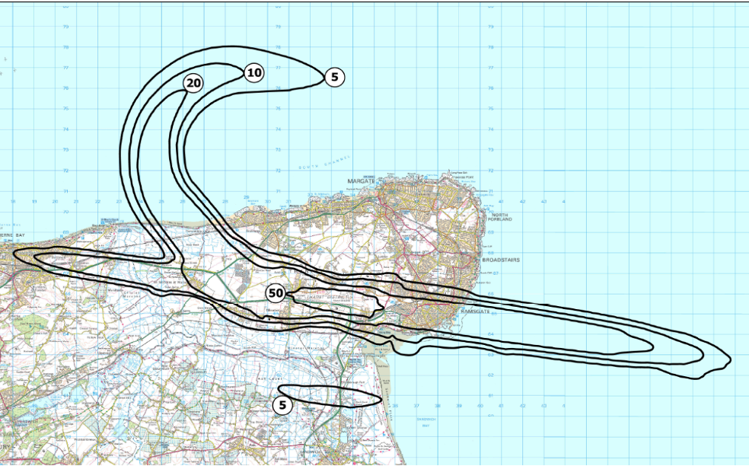
Combination B - Noise assessment
These maps show the N65 (day) noise assessments for the forecast Year 1 (2029) and Year 10 (2038). The contours show the number of events of noise exceeding 65dbA (N65) in the daytime, for an average 24 hours in the summer, that would be experienced by people living within the contour.
For further details see section 6.4 in the Consultation Document.
Night-Time Noise Assessment:
We have also assessed potential night-time noise (between 11pm and 7am).
In Year 1 (2029), there will be no scheduled night flights, so no night-time noise assessment is shown. For Year 10 (2038), our assessment found that no areas would experience five or more noise events above 60 decibels during the night, so no contours are displayed.
Year 1
Year 10

Slide 20


Your feedback
Call to action

Slide 21
Please tell us your views
We would appreciate your comments on the proposals.
You can respond to the consultation by completing an online form or by scanning the QR code.
Alternatively, you can submit a written response to our Freepost address: FREEPOST 1616
The consultation commenced on 16 March and runs until 22 June 2026.
Please note that a dedicated email address has been set up for general engagement and updates only
manstonairspace@communityrelations.co.uk.
Formal consultation feedback cannot be submitted via this address. Any responses received will be redirected to the
Citizen Space consultation portal.
We will accept your feedback until 22nd June 2026.

Slide 22
Join one of our events
We’ve hosted two in-person events and are hosting two online webinars where you can:
Find out more about the proposals
View large-scale maps and display boards
Ask questions and share feedback
Obtain a copy of our feedback questionnaire to submit a written response
Date | Time | Format | Location / Details
22nd April (Wed) | 4pm to 8pm | In person | San Clu Hotel, Victoria Parade, Ramsgate, CT11 8DT
25th April (Sat) | 1pm to 5pm | In person | Christ Church Hall, 47 William Street, Herne Bay, CT6 5AG
28th April (Tue) | 6:30pm to 7:30pm | Webinar | To join the webinar contact us via manston@communityrelations.co.uk
6th May (Wed) | 6:30pm to 7:30pm | Webinar | To join the webinar contact us via manston@communityrelations.co.uk

Slide 23
Next steps

Slide 24
Next steps
After the consultation, we will review and analyse all responses to understand views and identify key themes.
Feedback may lead to changes in the proposed airspace design.
We will publish a summary of responses and our analysis on Citizen Space and the Manston Airport website.
At Stage 4 of ACP formal Airspace Change Proposal (ACP) will be submitted to the CAA.
If approved, the new airspace design will be implemented once the airport becomes fully operational.
The CAA’s Airspace Change Portal will continue to be updated with the latest information as the ACP progresses.

Slide 25
Get in touch

Slide 26
Get in touch
To learn more about Manston Airport:
rsp.co.uk
manston@communityrelations.co.uk
If you have any questions about the ACP Stage 3 consultation, contact manstonairspace@communityrelations.co.uk.
To submit your feedback, please visit this link or scan the QR code.
We look forward to hearing from you and thank you for taking part.

Slide 27
Manston Airport Airspace Consultation – Stage 3
Q&A session

